Slide 1
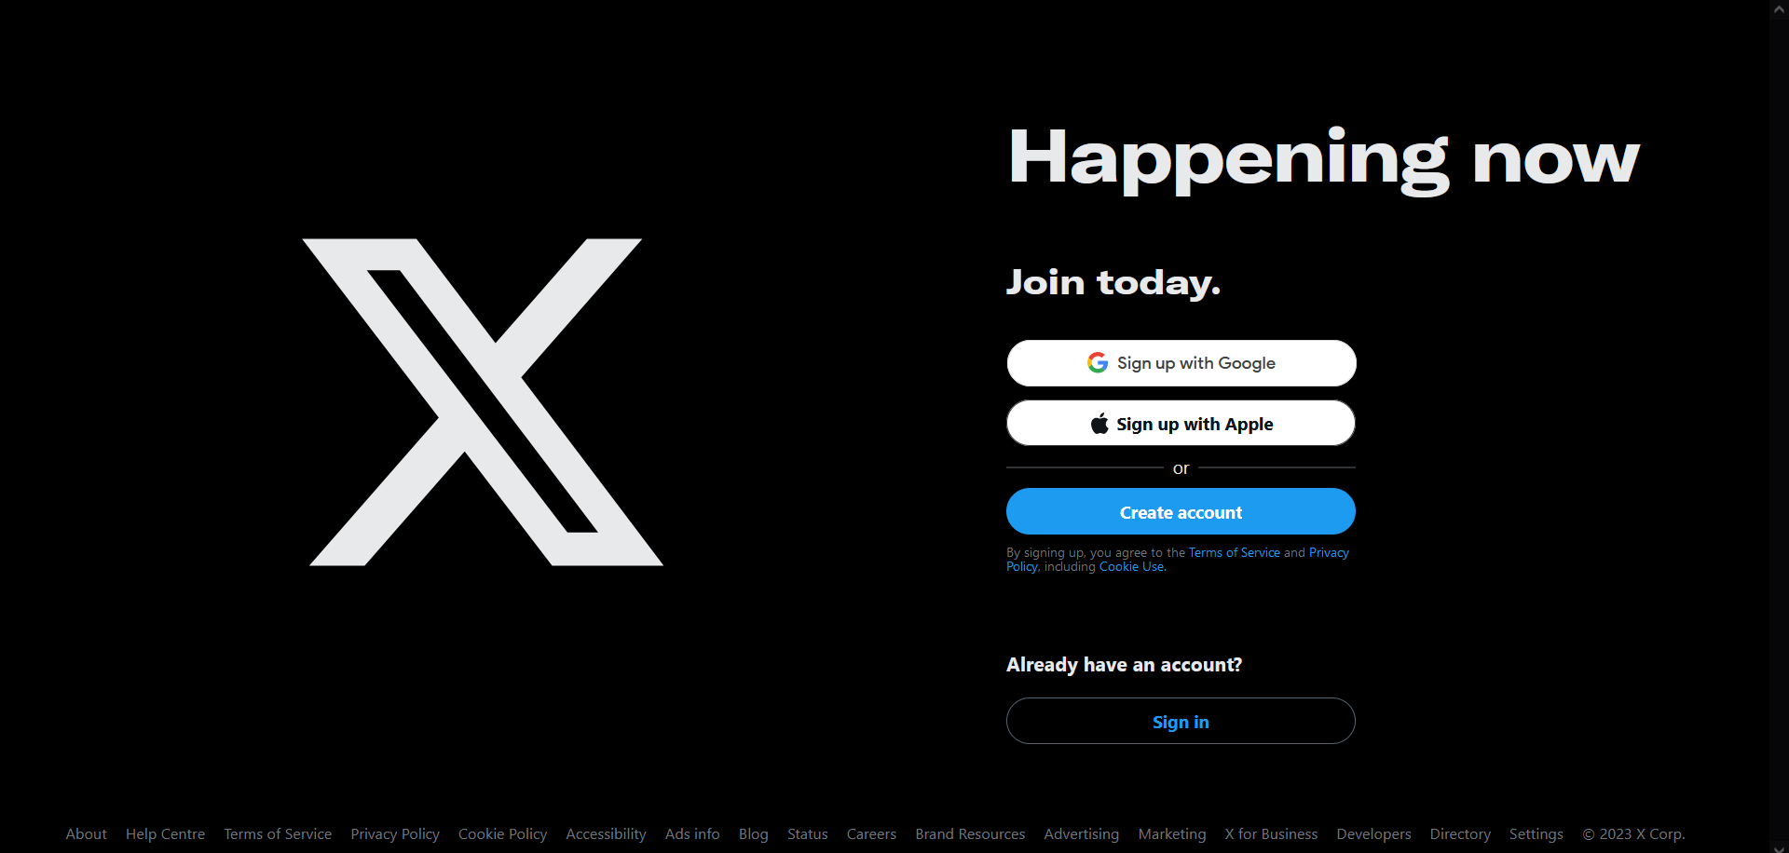
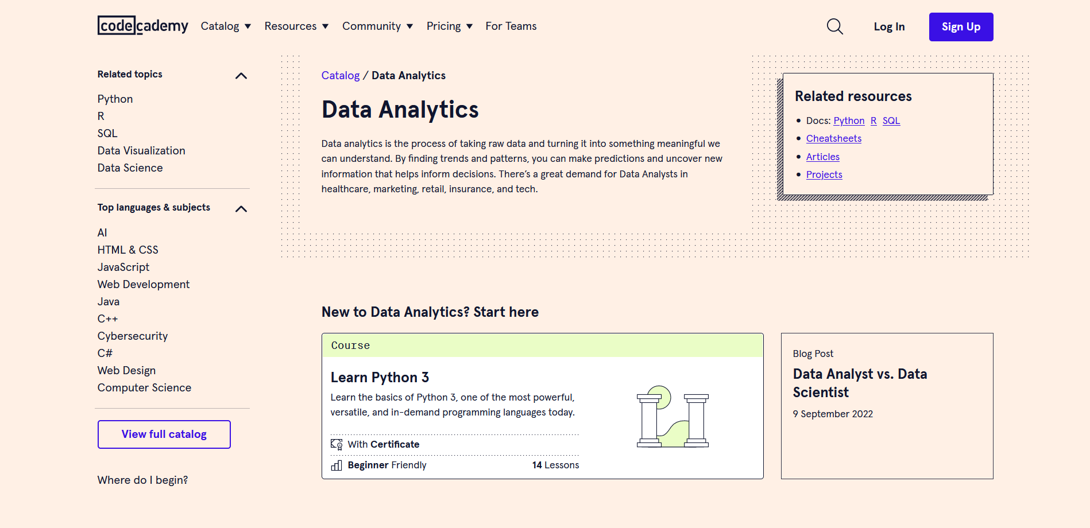

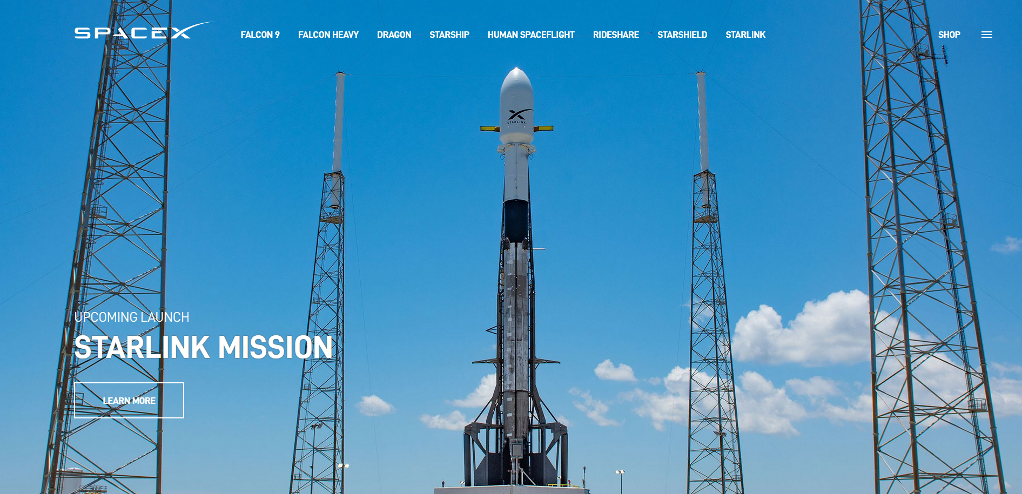
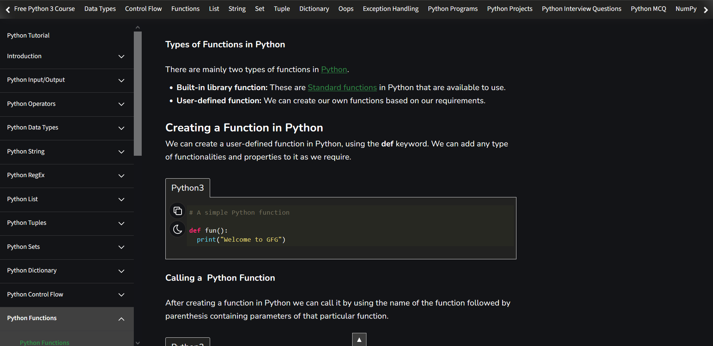
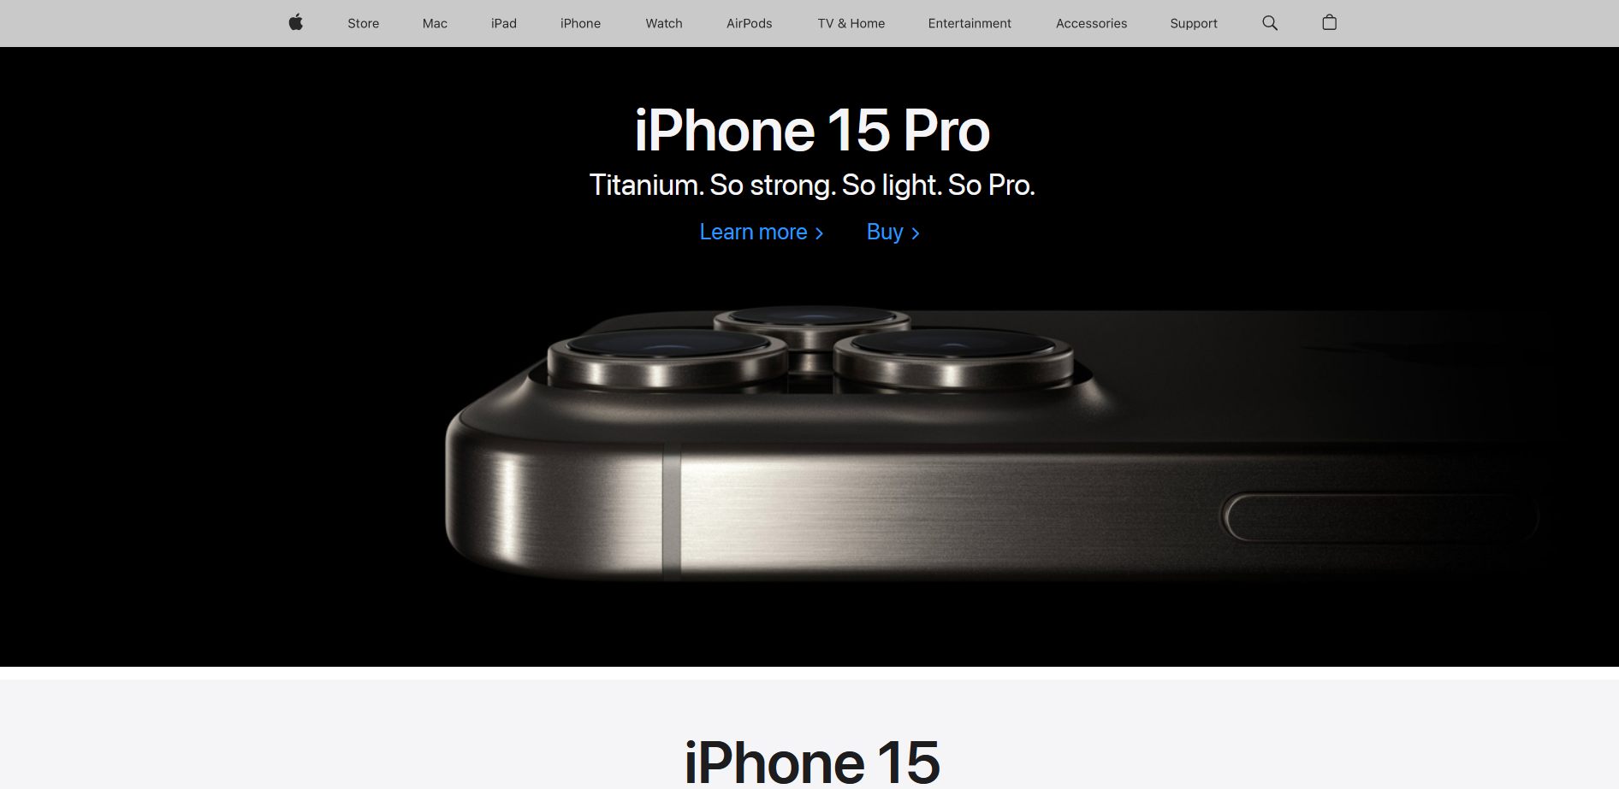
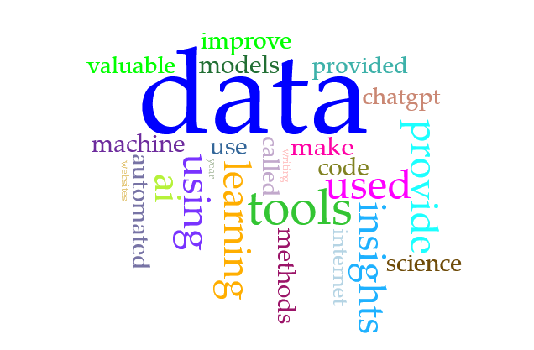
black + white, high contrast, space-age feel
drop-down menus
vintage computer console style
minimal, large photos, sleek
artificial intelligence
BIG DATA
40 trillion gigabytes per year
Data Storytelling…
INSIGHTS
Data-driven decisions

